Slide 1
CPSC 583 Expert Systems Design Theory
Dr. Anand Panangadan
apanangadan@fullerton.edu
Some slides are adapted from:
Dr. Franz J. Kurfess, Computer Science Department, Cal Poly, San Luis Obispo
Peter Jackson, Introduction To Expert Systems, 3rd edition
http://math.hws.edu/eck/cs453/s03/about_clips.html

Slide 2
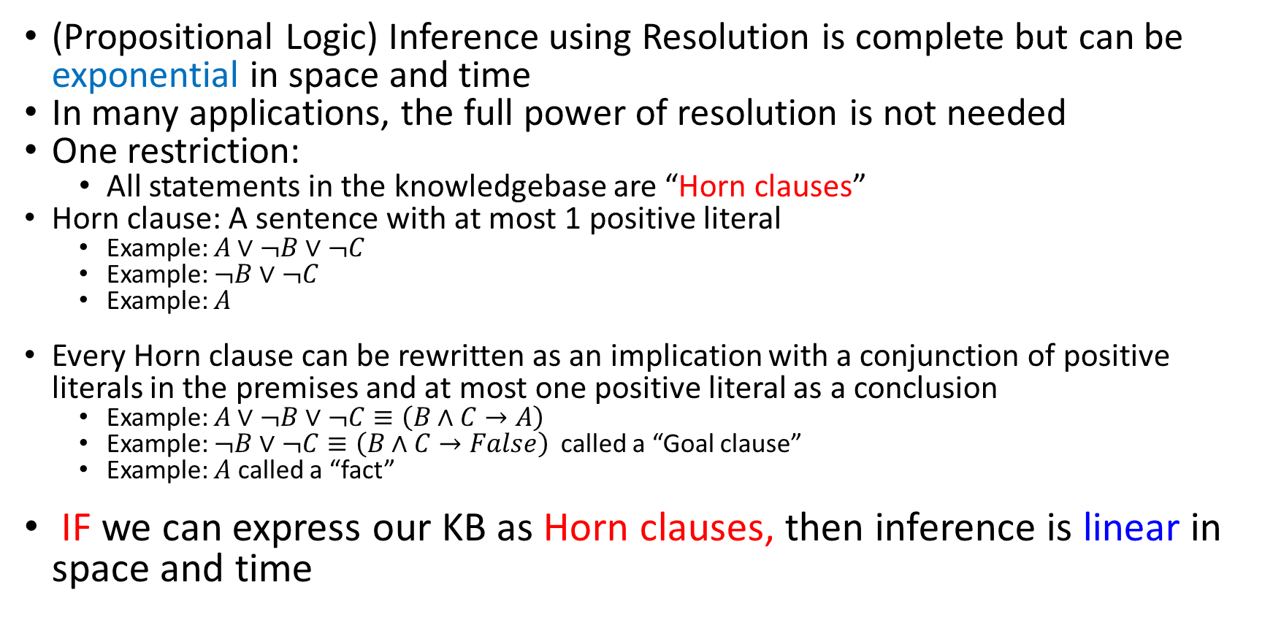
Horn Clauses
(Propositional Logic) Inference using Resolution is complete but can be exponential in space and time
In many applications, the full power of resolution is not needed
One restriction:
All statements in the knowledgebase are “Horn clauses”
Horn clause: A sentence with at most 1 positive literal
Example: $A∨¬B∨¬C$
Example: $¬B∨¬C$
Example: $A$
Every Horn clause can be rewritten as an implication with a conjunction of positive literals in the premises and at most one positive literal as a conclusion
Example: $A∨¬B∨¬C≡\left(B∧C→A\right)$
Example: $¬B∨¬C≡\left(B∧C→False\right)$ called a “Goal clause”
Example: $A$ called a “fact”
IF we can express our KB as Horn clauses, then inference is linear in space and time

Slide 3
Forward v. Backward chaining
Forward chaining is reasoning from facts to the conclusions resulting from those facts
In the Wumpus world:
Start from facts: stench(1,2)
Conclude: wumpus(2,2)
CLIPS
Backward chaining involves reasoning in reverse from a hypothesis - from a potential conclusion to be proved, to the facts that support the hypothesis
Start from goal: does square (2,2) contain the wumpus?
Backwards reasoning: Is so, then stench(1,2) V stench(2,1)? …
PROLOG

Slide 4
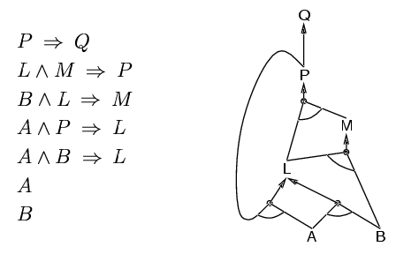
Forward chaining (FC)
Idea: fire any rule whose premises are satisfied in the KB, add its conclusion to the KB, until Query is found.
This proves that KB ⇒ Query is true
AND
To prove: Q
OR
Forward chaining is sound and complete for Horn KB

Slide 5
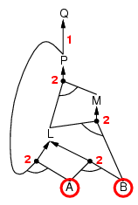
Forward chaining example
Numbers at each AND node indicate the number of outstanding preconditions yet to be satisfied before all of that AND node input preconditions have been satisfied. It is an efficient book-keeping mechanism for determining when an AND node is satisfied. The AND node is satisfied when its number of outstanding preconditions yet to be satisfied is zero.
“OR” Gate
“AND” gate

Slide 6
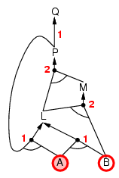
Forward chaining example

Slide 7
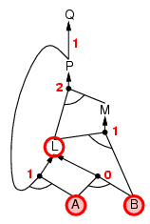
Forward chaining example

Slide 8
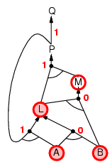
Forward chaining example

Slide 9
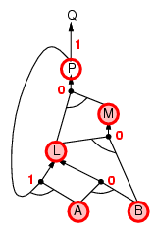
Forward chaining example

Slide 10
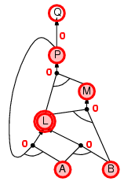
Forward chaining example

Slide 11
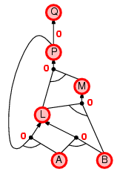
Forward chaining example

Slide 12
Production Rules
A Production Rule System emulates human reasoning using a set of ‘productions’
Productions have two parts
Sensory precondition (“IF” part)
Action (“THEN” part)
When the ‘world’ matches the IF part, the production is fired: the action is executed
The ‘world’ is the set of facts in the system’s working memory
Production rules link facts (“IF” parts) to conclusions (“THEN” parts)

Slide 13
What is CLIPS?
Knowledge-based system shell
empty tool, to be filled with knowledge
Forward-chaining
starting from the facts, a solution is developed
Pattern-matching
Not logical inference
Rete matching algorithm: find matching rules and facts
Multi-paradigm programming language
rule-based (primary), object-oriented (Cool) and procedural

Slide 14
What is CLIPS?
History
CLIPS stands for
C Language Integrated Production System
Influenced by OPS5 and ART
Production systems
Developed by NASA
Open source now; hosted on SourceForge
Runs on PC, Mac
CLIPS provides mechanisms for expert systems
Production rule interpreter
Implemented in C for efficiency and portability
Interpreted (not compiled)
LISP-like procedural language
Lisp is a functional programming language – everything is a function operating on a list
E.g.: Multiply(2,3) is written as (Multiply 2 3)
Object-oriented programming language extensions

Slide 15
What is CLIPS?
Extensions
Can embed CLIPS programs in C++
Call CLIPS engine from C++
JESS in Java

Slide 16
Components of CLIPS-based Expert System
Knowledge Base (KB)
Facts
First order logic (FOL) predicates in Lisp format
Rules
First order logic implications
CLIPS Inference engine
to match facts with rules

Slide 17
CLIPS Software
http://www.clipsrules.net/
Install CLIPS 6.4
Documentation
User’s Guide

Slide 18
Invoke / Exit CLIPS
entering CLIPS
interactive prompt appears:
CLIPS>
exiting CLIPS
at the system prompt
CLIPS> (exit)

Slide 19
CLIPS prompt
Executes a function
Infix notation
Function name comes first
(+ 1 2) instead of 1 + 2
evaluates to 3
Examples
(exit)
(+ 10 20)
(printout t Hello)

Slide 20
Hello world!
CLIPS> (printout t "Hello world" crlf)

Slide 21
Mathematical Operators
basic operators (+,-,*,/) and many functions (trigonometric, logarithmic, exponential) are supported
no built-in precedence, only left-to-right and parentheses
(sqrt (+ (** 4 2) (** 3 2)))
evaluates to 5

Slide 22
CLIPS Primitive Data Types
symbol:
e.g. this-is-a-symbol, is-raining
CLIPS is case-sensitive
string: delimited by double quotes
e.g. "This is a string"
Numbers
integer:
E.g., 42
float: decimal point (1.5) or exponential notation (3.7e10)
fact-address: “pointer” to a fact (index to the array of facts)

Slide 23
Ordered facts
A fact is a list of fields
(myfact)
(age 21)
(parent Rajeev Indira)
The order matters
(parent Rajeev Indira)
Think of it as a first order predicate
Parent(Rajeev, Indira)

Slide 24
Asserting Facts
Facts have to be asserted to enter working memory
CLIPS> (assert (parent Rajeev Indira))
<Fact-1>
Facts can be listed
CLIPS> (facts)
f-1 (parent Rajeev Indira)
See facts by opening the Facts window in the GUI

Slide 25
Rules
general format
(defrule <rulename> ["optional description"]
<pattern>
:
<pattern>
=>
<action>
:
<action>)
Logical implication

Slide 26
Rule Components
rule header
defrule keyword, name of the rule, optional description string
rule antecedent (LHS)
patterns to be matched against facts
LHS must match facts exactly
rule consequent (RHS)
actions to be performed when the rule fires

Slide 27
Examples of Rules
CLIPS>
(defrule parent-child
(parent Rajeev Indira)
=>
(assert (child Indira Rajeev)))
CLIPS>

Slide 28
Conflict resolution of rules
A rule + its matching patterns is called an activation
Activated rules are put on the Agenda
If either the rule or the pattern changes, the activation is removed
But multiple rules can be on the agenda
How to choose only one to be fired?
Conflict resolution to pick one

Slide 29
Conflict resolution of rules
Strategy
To select within rules of the same salience
Default strategy is depth: newly activated rules are placed above existing rules on the agenda
Depth-first search
Breadth strategy: newly activated rules placed below existing rules.
Breadth-first search
Specificity strategy: use the most specific rule (the one with the most conditions attached).
To change strategy:
(set-strategy breadth)
Refraction
After a rule is fired, it is removed from the agenda
Without refraction, expert systems always would be caught in trivial loops
Salience
CLIPS Inference Engine sorts the activations according to their salience
Salience range for a rule can be specified in range (-10,000 to +10,000)
Default salience = 0
CLIPS executes the RHS of the rule with the highest salience on the agenda

Slide 30
CLIPS main loop
Facts
A
B
C
Agenda
(activated rules)
Rule 1, F-1
Rule 2, F-3
Execute activated rule with highest salience
Remove this rule from agenda
Pattern matching
Rules
A->D
C->E
D->F

Slide 31
CLIPS main loop
Facts
A
B
C
D
Agenda
(activated rules)
Rule 1, F-1
Rule 2, F-3
Rule 3, F-4
Execute most-recently activated rule (depth-first strategy)
Remove this rule from agenda
Pattern matching
Rules
A->D
C->E
D->F

Slide 32
CLIPS main loop
Facts
A
B
C
D
F
Agenda
(activated rules)
Rule 1, F-1
Rule 2, F-3
Rule 3, F-4
Execute activated rule Remove this rule from agenda
Pattern matching
Rules
A->D
C->E
D->F

Slide 33
CLIPS main loop
Facts
A
B
C
D
F
E
Agenda
(activated rules)
Rule 1, F-1
Rule 2, F-3
Rule 3, F-4
Agenda is empty
(halt)
Pattern matching
Rules
A->D
C->E
D->F

Slide 34
Program stops when …
No more activated rules
Empty agenda
a rule fires which specifically tells the system to halt
(halt)

Slide 35
Execution of a Program
(reset) prepares (re)start of a program:
all previous facts are deleted
initial facts are asserted
rules matching these facts are put on the agenda
(run) starts the execution
(run 1)
Single stepping one rule at a time

Slide 36
Variables
variables
symbolic name beginning with a question mark "?"
variable bindings
variables in a rule pattern (LHS) are bound to the corresponding values in the fact, and then can be used on the RHS
all occurrences of a variable in a rule have the same value
the left-most occurrence in the LHS determines the value
bindings are valid only within one rule

Slide 37
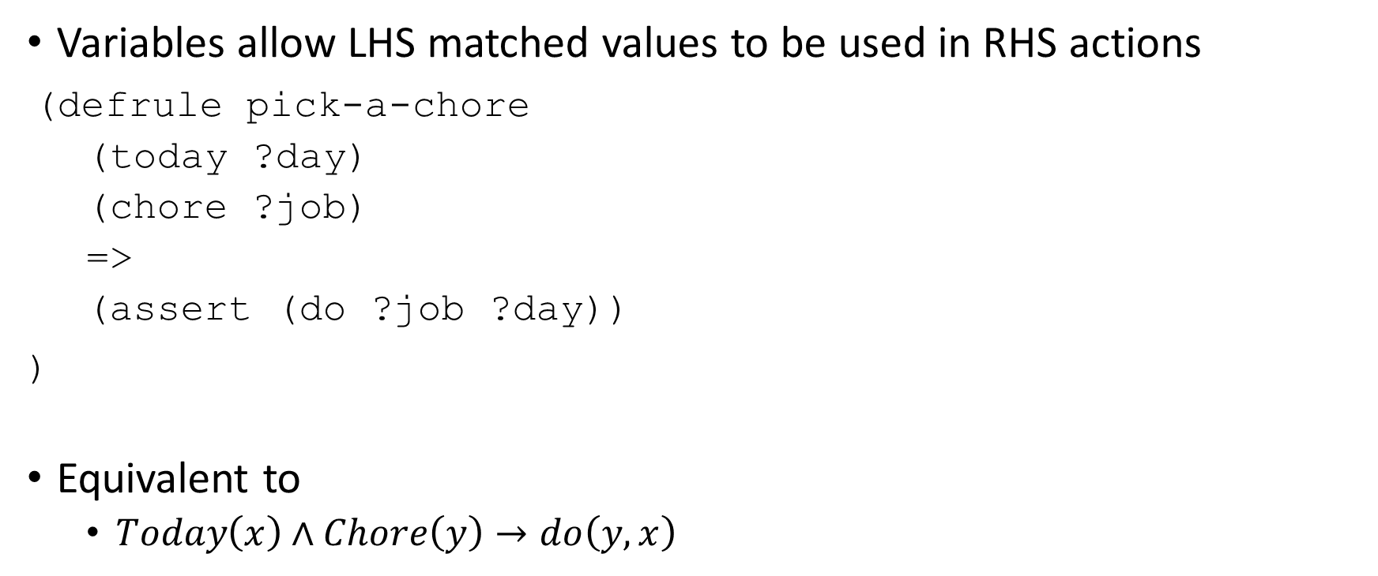
Variables & Pattern Matching
Variables allow LHS matched values to be used in RHS actions
(defrule pick-a-chore
(today ?day)
(chore ?job)
=>
(assert (do ?job ?day))
)
Equivalent to
$Today\left(x\right)∧Chore\left(y\right)→do\left(y,x\right)$

Slide 38
Example
(assert (parent Rajeev Indira))
(assert (parent Rahul Rajeev))
(defrule parent-rahul
(parent Rahul ?name)
=>
(printout t "parent of Rahul is " ?name crlf)
)

Slide 39
Class work
Install CLIPS 6.4
http://www.clipsrules.net/
Run the “Hello world” program:
(printout t "Hello world!" crlf)
Run the program in the previous slide
parent-Rahul
Write a new rule to print a list of all parents and their children
parent of Rahul is Rajeev
parent of Rajeev is Indira

Slide 40
Unordered (named field) facts
Facts with named fields
Similar to C struct fields
slots
Zero or more symbolic fields with associated values
deftemplate construct
used to define the structure of a fact
names and number of slots
Each parameter is given a name
Advantage: can “instantiate” a deftemplate fact by specifying values to some of the parameters
(deftemplate person "deftemplate example"
(slot name)
(slot age))

Slide 41
Instances
an instance of a fact is created by
(assert (person (name Rajeev)
(age 46))

Slide 42
Can give defaults and type to each parameter
CLIPS> (deftemplate person
(slot name (type STRING))
(slot age (type NUMBER) (default 18)))
CLIPS> (assert (person (name Rahul))) ; error!
CLIPS> (assert (person (name "Rahul")))

Slide 43
Grouping together facts
deffacts
used to group together facts
define initial groups of facts
deffacts gandhi-family …
Represents permanent or background knowledge necessary for the program
(reset) command puts these background facts into working memory

Slide 44
Initial Facts
(deffacts gandhis "some members of the Gandhi family"
(person (name Rajeev) (age 46))
(person (name Indira) (age 64))
(person (name Rahul) (age 46))
(person (name Priyanka) (age 44))
)

Slide 45
Variable matching
CLIPS> (deftemplate person
(slot name (type STRING))
(slot age (type NUMBER) (default 18)))
CLIPS> (assert (person (name "Rahul")))
CLIPS> (defrule print-a-person
(person (name ?name) (age ?age))
=>
(printout t name? " is " ?age " years old" crlf)
)

Slide 46
Loading a program file
clearing the CLIPS environment
(clear)
removes all constructs
Easier to write longer programs in a separate text editor
*.clp
Then, load into CLIPS

Slide 47
CLIPS programming example: Sibling problem
Consider the following facts in CLIPS format
(deffacts gandhis "(parent x y) means x has parent y"
(parent Rajeev Indira)
(parent Sanjay Indira)
(parent Rahul Rajeev)
(parent Priyanka Rajeev)
(parent Rahul Sonia)
(parent Priyanka Sonia)
)
Write CLIPS code to list all pairs of siblings
Two people are siblings if they share a parent

Slide 48
Field Constraints
not constraint ~
the field can take any value except the one specified
or constraint |
specifies alternative values, one of which must match
and constraint &
the value of the field must match all specified values
mostly used to place constraints on the binding of a variable

Slide 49
Example Rule with Field Constraints
(color red|green|blue)
matches (color red) or (color green) or (color blue)
(color ~red)
match any color fact in which the color is not red.
(color ~black&~white)
match facts where is not black and is not white.

Slide 50
Binding a variable to a field with constraints
Use a variable with the & constraint
(color ?c&~black&~white)
(defrule constraint-match …
Examples in tutorial.clp

Slide 51
Sibling problem 2
Modify the siblings code to ensure that siblings should be distinct
(i.e., do not list (Rajeev, Rajeev)).

Slide 52
Wildcards
question mark ?
matches any single field within a fact
multi-field wildcard $?
matches zero or more fields in a fact

Slide 53
Wildcards
(do washing on monday)
one-to-one matching
(do ?job on ?day)
use of wild cards
(do ? ? monday)
(do ? on ?)
(do ? ? ?day)
(do $?)
(do $? monday)
(do ?chore $?when)
[Jackson 1999]

Slide 54
Usage of Facts
adding facts
(assert)
deleting facts
(retract 1)
modifying facts
(modify <fact-index> (<slot-name> <slot-value>)+ )
retracts the original fact and asserts a new, modified fact
inspection of facts
(facts)
prints the list of facts
(watch facts)
automatically displays changes to the fact list

Slide 55
Retracting facts
Retracting facts
CLIPS> (assert (married Indira Feroze))
CLIPS> <Fact-10>
(married Indira Feroze) is fact #10 in KB
CLIPS> (assert (divorced Indira Feroze))
Must remove an invalid fact
CLIPS> (retract 10)
(married Indira Feroze) is removed from KB

Slide 56
Modifying facts
(defrule birthday-rule
(person (name Rahul)
(age 49))
(date-today June-19-2019)
=>
(printout t "Happy birthday, Rajeev!")
(modify 1 (age 50))
)
Fact number 1. How to get this?
Assign to a fact pointer during matching

Slide 57
More complex patterns
pattern connectives
multiple patterns in the LHS are implicitly AND-connected
patterns can also be explicitly connected via AND, OR, NOT

Slide 58
Sibling problem 3
Modify the code to ensure that a pair is printed only once
do not output (Rajeev, Sanjay) if (Sanjay, Rajeev) is already listed

Slide 59
CLIPS commands: functions
Difference between evaluating an expression and just listing it on the LHS of a rule
(defrule age-rule (age (+ 24 1)) => (printout t “Age matches”))
This gives an error because there is an invalid pattern
(defrule age-rule (age =(+ 24 1)) => (printout t “Age matches”))
Equivalent to (age 25)
Use = to evaluate an expression in the LHS

Slide 60
More complex patterns
test
evaluates an expression in the LHS instead of matching a pattern against a fact
(test (>= ?b ?a))
Very useful!
(defrule older-than …

Slide 61
CLIPS programming example
(deffacts gandhis "some members of the Gandhi family"
(person (name Rajeev) (age 46))
(person (name Indira) (age 64))
(person (name Rahul) (age 46))
(person (name Priyanka) (age 44))
)
List all pairs with the older person first
E.g. "Rahul is older than Priyanka"

Slide 62
Retracting Facts from a Rule
(defrule do-a-chore
(today ?day)
?chore <- (do ?job on ?day)
=>
(printout t ?job “ done”)
(retract ?chore)
)
Facts can be retracted
CLIPS> (retract 0)
a variable must be assigned to the item for retraction
Fact number assigned to a fact pointer during matching

Slide 63
Retracting facts automatically
CLIPS> (retract 10)
Define a rule for this
But how to get the fact number?
Fact pointer
CLIPS> (defrule delete-marriage
(divorced ?a ?b)
?marriage <- (married ?a ?b)
=>
(retract ?marriage)
)

Slide 64
CLIPS Programming example: Print oldest person
Print the oldest person
E.g. “Indira is the oldest"
(defrule oldest-person …

Slide 65
CLIPS programming example: Blocks world
A
D
Have a set of named Blocks
Blocks can be stacked
Only action allowed: Move
Move one block to top of another
Move one block to floor
BUT cannot move a block if another on top of it
Problem:
What is the sequence of moves to rearrange blocks into some desired configuration?
Eg: Block A on top of C
B
E
C
F
Floor

Slide 66
CLIPS programming example
The buckets game
Given two buckets of capacity 3 and 5 gallons
Fill one bucket with exactly a given number of gallons of water
No measuring! Only pouring.
Fill a bucket completely
Pour out all the water in a bucket
Pour water from one bucket to another until one is empty/full

Slide 67
CLIPS programming example
Write a CLIPS program to calculate the moves to reach a given amount of water
Input to the program from the user:
Target number of gallons
Assume initially both buckets are empty

Slide 68
CLIPS commands: display
Displaying the current status of the CLIPS interpreter
(facts)
Display a list of facts
(rules)
Display a list of rules
(agenda)
Display all activated rules

Slide 69
CLIPS commands: creating facts
(assert fact)
Insert fact into working memory
(deffacts factname list_of_facts)
Insert a group of facts; also reinserted after a (reset)

Slide 70
CLIPS commands: execution
(exit)
Exit from CLIPS
(clear)
Remove facts and rules from working memory
(reset)
Reset only the facts
sets (initial-fact), and all (deffacts)
Perform (reset) before a (run)
(run)
Executes using currently loaded rules and facts until agenda is empty
(halt)
Stop even if agenda is not empty
Eg: Goal is reached

Slide 71
Manipulation of Constructs
show list of constructs
(list-defrules), (list-deftemplates), (list-deffacts)
prints a list of the respective constructs
show text of constructs
(ppdefrule <defrule-name>), (ppdeftemplate <deftemplate-name>), (ppdeffacts <deffacts-name>)
displays the text of the construct (``pretty print'')
deleting constructs
(undefrule <defrule-name>), (undeftemplate <deftemplate-name>), (undeffacts <deffacts-name>)
deletes the construct (if it is not in use)
clearing the CLIPS environment
(clear)
removes all constructs and adds the initial facts to the CLIPS environment

Slide 72
Input / Output
print information
(printout <logical-device> <print-items>*)
logical device frequently is the standard output device t (terminal)
terminal input
(read [<logical-device>]), (readline [<logical-device>])
read an atom or string from a logical device
the logical device can be a file which must be open
open / close file
(open <file-name> <file-ID> [<mode>]), (close [<file-ID>])
open /close file with <file-id> as internal name
load / save constructs from / to file
(load <file-name>), (save <file-name>)
backslash \ is a special character and must be ``quoted'' (preceded by a backslash \)
e.g. (load "B:\\clips\\example.clp")

Slide 73
User defined functions
(deffunction function-name (arg ... arg)
action ... action)
(deffunction hypotenuse (?a ?b)
(sqrt (+ (* ?a ?a) (* ?b ?b))))
(deffunction initialize ()
(clear)
(assert (today is sunday)))
External functions written in C or other languages can be integrated
[Jackson 1999]

Slide 74
Program Execution
(agenda) displays all activated rules
refraction
rules fire only once for a specific set of facts
prevents infinite loops
(refresh <rule-name>)
reactivates rules

Slide 75
Watching
watching the execution
(watch <watch-item>) prints messages about activities concerning a <watch-item>
(facts, rules, activations, statistics, compilation, focus, all)
(unwatch <watch-item>)
turns the messages off

Slide 76
Watching Facts, Rules and Activations
facts
assertions and retractions of facts
rules
message for each rule that is fired
activations
rules on the agenda

Slide 77
JESS: an alternative to CLIPS
JESS stands for Java Expert System Shell
it uses the same syntax and a large majority of the features of CLIPS
tight integration with Java
can be invoked easily from Java programs
can utilize object-oriented aspects of Java
some incompatibilities with CLIPS
COOL replaced by Java classes
a few missing constructs
more and more added as new versions of JESS are released

Slide 78
Limitations of production systems
The basic control flow is forward chaining
to implement other kinds of reasoning you have to manipulate tokens in working memory
[Jackson 1999]

Slide 79
Limitations of production systems
Because of the effect of conflict resolution strategies, rules interact and the order of rules matters.
Cannot fully understand a rule by reading it in isolation
Must consider the conflict resolution strategy
Under which circumstances will a rule fire?

Slide 80
Limitations of production systems
Attempting to expand a production system by simply adding more rules can have unintended consequences
Unexpected rule interactions
Need to consider all possible rule interactions makes large rule-based systems hard to update

Slide 81
Limitations of production systems
Domain experts find it easy to grasp the meaning of individual rules
But NOT easy to grasp these issues concerned with interactions

